Slide 1
Trust Me, I’m Partially Right: Incremental Visualization Lets Analysts Explore Large Datasets Faster
Danyel Fisher et al
Microsoft Research & University of Southampton
CHI2012

Slide 2
Data Visualizations: Why?
Analyze
Discover trends
Stock price is going up/down
Develop hypotheses
House prices are down due to the downturn
Check hypotheses
Detect errors
Null values in a column
Share, record & communicate

Slide 3
Data Visualizations Flow
Image / Chart
View
Relations
Data
Notes:
We can automate parts of the workflow by looking at potentially interesting views or visualizations
Thus, a view is potentially interesting if… like in this case
Given this idea, can we
Save significant work for the analyst of stepping through…

Slide 4
Types of Data
Nominal
=, ≠
Ordinal
=, ≠, <, >
Quantitative Interval
=, ≠, <, >, –
Arbitrary zero
Quantitative Ratio
=, ≠, <, >, –, %
Physical quantities
Airlines, Genre
MPAA Rating,
Batteries
Year, Location
Sales, Profit
Temperature
Notes:
We can automate parts of the workflow by looking at potentially interesting views or visualizations
Thus, a view is potentially interesting if… like in this case
Given this idea, can we
Save significant work for the analyst of stepping through…

Slide 5
Conversion of Data Types
Nominal
=, ≠
Ordinal
=, ≠, <, >
Quantitative Interval
=, ≠, <, >, –
Arbitrary zero
Quantitative Ratio
=, ≠, <, >, –, %
Physical quantities
Hot, warm, cold
Well, so-so, badly
Grade
Temperature
Score
Notes:
We can automate parts of the workflow by looking at potentially interesting views or visualizations
Thus, a view is potentially interesting if… like in this case
Given this idea, can we
Save significant work for the analyst of stepping through…

Slide 6
Data Transformations: Single Attribute
Binning & Grouping
Dealing with Large Cardinalities
Per Hour
Per Day
Per Week
Per Month
Bin by hour
Bin by day
Bin by week
Bin by month
Notes:
We can automate parts of the workflow by looking at potentially interesting views or visualizations
Thus, a view is potentially interesting if… like in this case
Given this idea, can we
Save significant work for the analyst of stepping through…

Slide 7
Data Transformations: Single Attribute
Making it easier to see the point
Normalization
Logarithm
Power
Cumulative vs. Aggregate
Aid comparisons, reduce random variations
Notes:
We can automate parts of the workflow by looking at potentially interesting views or visualizations
Thus, a view is potentially interesting if… like in this case
Given this idea, can we
Save significant work for the analyst of stepping through…

Slide 8
OLAP Terminology
Star Schema: for simplicity, consider as a single relation, with many dimensions and measures Relation of transactions
Measures: values that can be
measured and aggregated
Sales, Profit
Dimensions: independent variables
Location, Category of Sale, Year
Notes:
All metrics essentially capture
Probability distributions
Like in this case..
So we can use any or all of these metrics. Of course we do not want to be tied down to any single metric.

Slide 9
Data Transformation: Aggregation Operators
The measure attributes will be aggregated
Standard SQL aggregations:
COUNT, SUM, AVG, MAX/MIN, STD DEV
Notes:
All metrics essentially capture
Probability distributions
Like in this case..
So we can use any or all of these metrics. Of course we do not want to be tied down to any single metric.

Slide 10
Canonical OLAP Query = Canonical Visualization Query
SELECT AGG(M), D
FROM R
WHERE …
GROUP BY D
SELECT SUM(Sales), Category
FROM R
WHERE State = “California”
GROUP BY Category
Can get more complicated with arbitrary binning, transformation, combining multiple attributes
Notes:
All metrics essentially capture
Probability distributions
Like in this case..
So we can use any or all of these metrics. Of course we do not want to be tied down to any single metric.

Slide 11
Types of Charts
Bar Charts
Line Charts
Scatter Plot
Chloropleth
Notes:
We can automate parts of the workflow by looking at potentially interesting views or visualizations
Thus, a view is potentially interesting if… like in this case
Given this idea, can we
Save significant work for the analyst of stepping through…

Slide 12
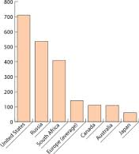
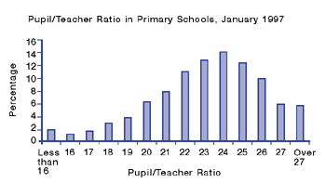
Bar Charts
Notes:
We can automate parts of the workflow by looking at potentially interesting views or visualizations
Thus, a view is potentially interesting if… like in this case
Given this idea, can we
Save significant work for the analyst of stepping through…

Slide 13
Bar Charts
Plotting a Q-R vs. either a N, O, Q-I, or Q-R
Emphasize more the difference in height than the distances in the x axis
Most fundamental chart
Notes:
We can automate parts of the workflow by looking at potentially interesting views or visualizations
Thus, a view is potentially interesting if… like in this case
Given this idea, can we
Save significant work for the analyst of stepping through…

Slide 14
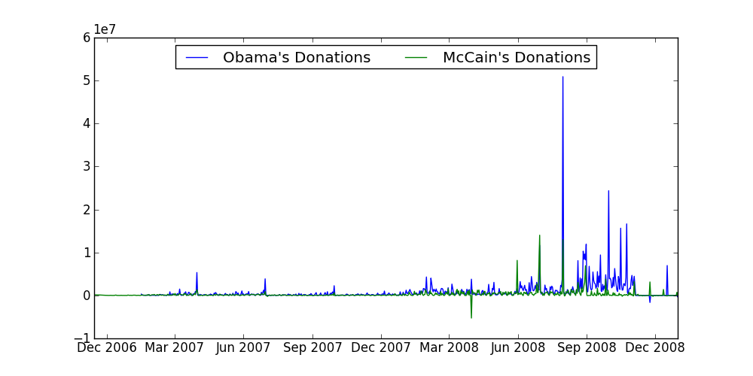
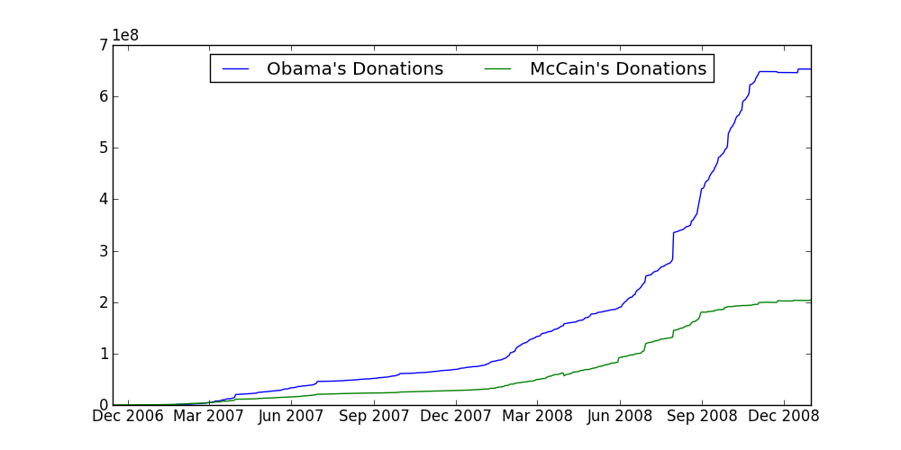
Line Charts

Slide 15
Line Charts
Plotting a Q-R vs. a Q-I, or Q-R
Mainly makes sense when the x-axis is ordered in some way
Want to be able to see “trends”
Assumption of interpolation, dependence
Notes:
We can automate parts of the workflow by looking at potentially interesting views or visualizations
Thus, a view is potentially interesting if… like in this case
Given this idea, can we
Save significant work for the analyst of stepping through…

Slide 16
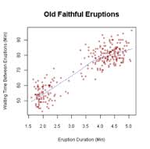
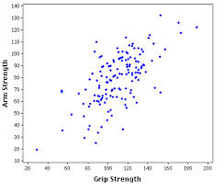
Scatter Plot
Notes:
We can automate parts of the workflow by looking at potentially interesting views or visualizations
Thus, a view is potentially interesting if… like in this case
Given this idea, can we
Save significant work for the analyst of stepping through…

Slide 17
Scatterplot
Plotting a Q-R vs. a Q-R
Unlike line graphs, no assumption of interpolation
Care more about “density”, understanding of “correlation”
Notes:
We can automate parts of the workflow by looking at potentially interesting views or visualizations
Thus, a view is potentially interesting if… like in this case
Given this idea, can we
Save significant work for the analyst of stepping through…

Slide 18
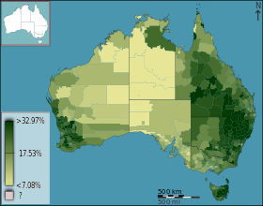
Chloropleths
Notes:
We can automate parts of the workflow by looking at potentially interesting views or visualizations
Thus, a view is potentially interesting if… like in this case
Given this idea, can we
Save significant work for the analyst of stepping through…

Slide 19
Chloropleth
Overlaid on a map
Q-R vs. Two-dimensional Q-I variable
Notes:
We can automate parts of the workflow by looking at potentially interesting views or visualizations
Thus, a view is potentially interesting if… like in this case
Given this idea, can we
Save significant work for the analyst of stepping through…

Slide 20
Q: What would you use to visualize…
Number of forest fires by county
Mean temperature over time
Sales per product category
Research spending versus number of Nobel laureates

Slide 21
Data Visualization Software
d3
ggplot2
Google Charts
Gnuplot
Easier to use & learn
Customizable
Also, analytics software: Tableau, Spotfire
Notes:
We can automate parts of the workflow by looking at potentially interesting views or visualizations
Thus, a view is potentially interesting if… like in this case
Given this idea, can we
Save significant work for the analyst of stepping through…

Slide 22
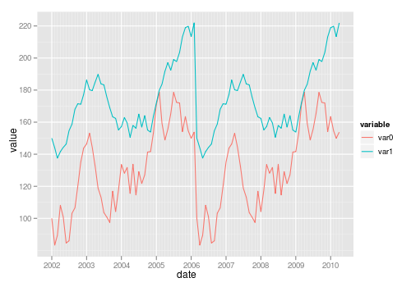
Data Visualization Software
Almost all the tools described will be able to plot something like this

Slide 23
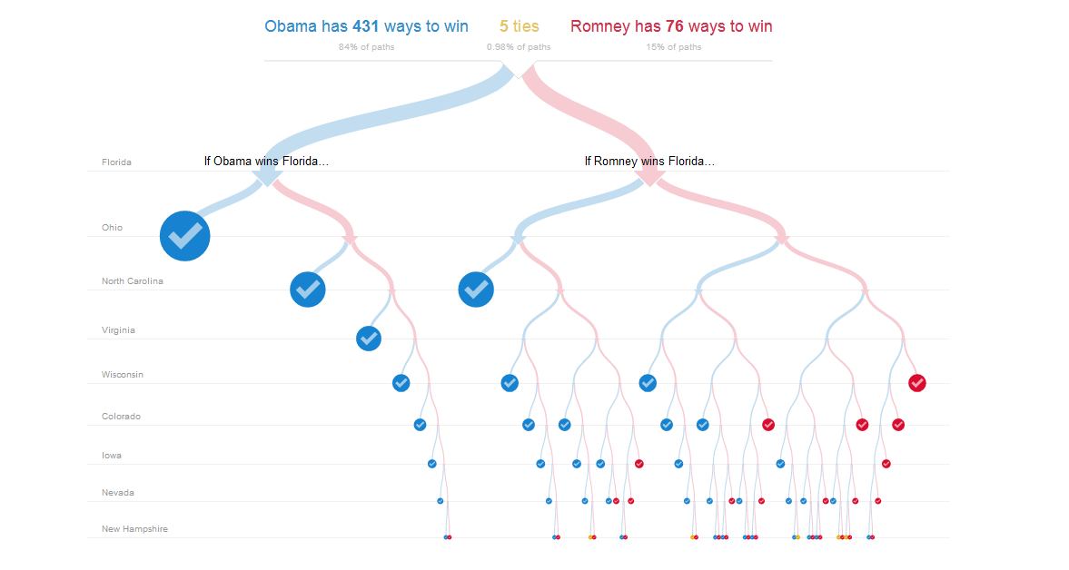
Data Visualization Software: d3

Slide 24
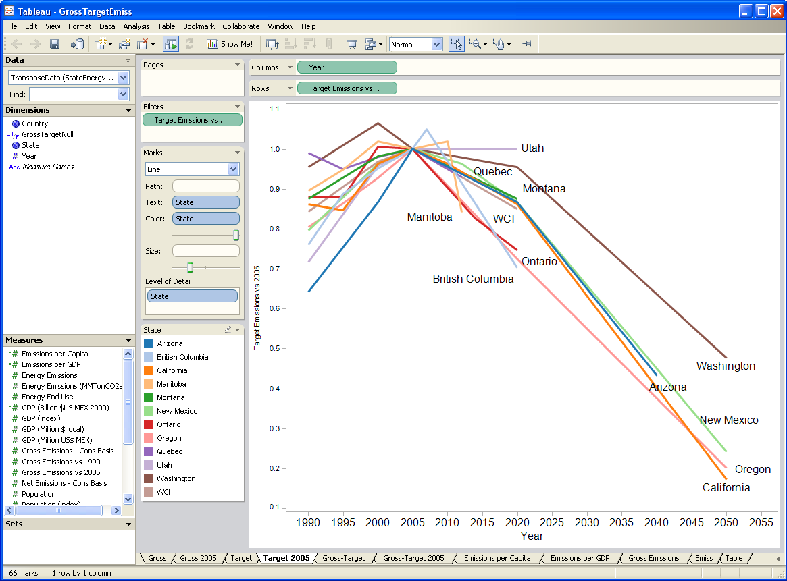
Data Analytics Tools: Tableau

Slide 25
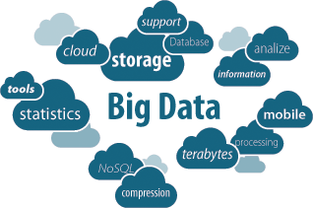
What is the problem?
Notes:
We live in a world of big data where everything is being stored and saved and fed into algorithms
people could be collecting anything - from your clicks in your social networking sites to highway traffic flows to what you are searching online when and where you are logging in from
so what do we do with this data?

Slide 26
What is the problem?
Return to the batch processing era
Submit job, find out results over night
No instant responses for queries
Some tools to alleviate this:
Dremel-like ||al processing
Spark-SQL-like memory-oriented exec
BlinkDB-like sample execution
Not fast enough!
Notes:
So these are the main problem the authors points out in the paper. Lot of analysts rely on batch-jobs, where they run queries overnight and then come back in the morning to see the results. This is a pretty exaggerated example from the paper, but I can see some quires running from 5-30 minutes. I know we have read a lot about database systems that are specialized for analysts and return results quickly, but they are not available to everyone and restricted to the type of queries you can run. And one thing that the authors point out is that step backwards from the interactive querying. that we expect in exploratory data analysis.
I just don’t know how well known these database systems are in the industry. I imagine Spark might be well known, but I don’t know if smaller scale analysts are going to use these types of systems. If you are a business consultant going through maybe 200gb of data you might just stick to regular sql
and I would imagine that it takes some times and effort (money and resources)
Anyone have comments on why people would not use spark or dremel?

Slide 27
What is the problem?
What does this mean for analysis? How does it adversely affect it?
Notes:
So these are the main problem the authors points out in the paper. Lot of analysts rely on batch-jobs, where they run queries overnight and then come back in the morning to see the results. This is a pretty exaggerated example from the paper, but I can see some quires running from 5-30 minutes. I know we have read a lot about database systems that are specialized for analysts and return results quickly, but they are not available to everyone and restricted to the type of queries you can run. And one thing that the authors point out is that step backwards from the interactive querying. that we expect in exploratory data analysis.
I just don’t know how well known these database systems are in the industry. I imagine Spark might be well known, but I don’t know if smaller scale analysts are going to use these types of systems. If you are a business consultant going through maybe 200gb of data you might just stick to regular sql
and I would imagine that it takes some times and effort (money and resources)
Anyone have comments on why people would not use spark or dremel?

Slide 28
What is the problem?
What does this mean for analysis?
Restrict the space of queries and therefore
hypotheses
avenues of exploration
Restrict the number of queries
Queries must be carefully designed and error free
Notes:
So these are the main problem the authors points out in the paper. Lot of analysts rely on batch-jobs, where they run queries overnight and then come back in the morning to see the results. This is a pretty exaggerated example from the paper, but I can see some quires running from 5-30 minutes. I know we have read a lot about database systems that are specialized for analysts and return results quickly, but they are not available to everyone and restricted to the type of queries you can run. And one thing that the authors point out is that step backwards from the interactive querying. that we expect in exploratory data analysis.
I just don’t know how well known these database systems are in the industry. I imagine Spark might be well known, but I don’t know if smaller scale analysts are going to use these types of systems. If you are a business consultant going through maybe 200gb of data you might just stick to regular sql
and I would imagine that it takes some times and effort (money and resources)
Anyone have comments on why people would not use spark or dremel?

Slide 29
Solution?
Visualize incremental estimates, as they are being generated!
Can be applied on any ”online sampling”-based database
via an Online Aggregation-like execution
Use samples to extrapolate final values & provide confidence intervals
Place control in the hands of users ➔ no waiting for long queries to finish!
Notes:
One thing to note is that this system (sampleAction) is not trying to solve the same problem as the database systems we have been reading about.
So it is not about building the fastest system or how to deal with parallel computing
being able to explore the data rapidly, just like how you would use a visualization. so a lot of times when you are looking at a visualizations (or creating one) you expect people to explore the data and lot of times they dont know what they are looking for - they are looking for trends and outliers

Slide 30
A Brief Detour of Online Aggregation (OA)
Simple idea: from the 90s
Sample increasing random portions of your data & provide confidence interval guarantees
Users control the groups of interest and the rates of sampling
Notes:
One thing to note is that this system (sampleAction) is not trying to solve the same problem as the database systems we have been reading about.
So it is not about building the fastest system or how to deal with parallel computing
being able to explore the data rapidly, just like how you would use a visualization. so a lot of times when you are looking at a visualizations (or creating one) you expect people to explore the data and lot of times they dont know what they are looking for - they are looking for trends and outliers

Slide 31
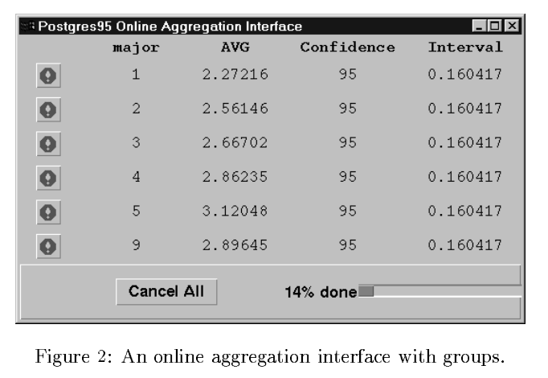
OA - Interface
Hellerstein, J. M., Haas, P. J., & Wang, H. J. (1997). Online aggregation. ACM SIGMOD Record, 26(2), 171-182.
Notes:
compared to this interface..
visualizations do help!

Slide 32
Technical Challenges
Unlike BlinkDB, no pre-materialized samples; just sample random tuples on the fly, possibly using secondary indexes
Why could this be very slow?
Notes:
Tableau allowed rapid queries against in-memory portion of dataset, but does not provide error bounds.
Infobright supports approximate SQL, but does not improve incrementally

Slide 33
Technical Challenges
Unlike BlinkDB, no pre-materialized samples; just sample random tuples on the fly, possibly using secondary indexes
Why could this be very slow? Random seek/sample, especially on disk
Can be faster in memory or on flash
Subsequent work extended to joins Even as recently as last year, a OA-based join algorithm won the best paper award at SIGMOD!
Notes:
Tableau allowed rapid queries against in-memory portion of dataset, but does not provide error bounds.
Infobright supports approximate SQL, but does not improve incrementally

Slide 34
Benefits over BlinkDB
What are possible benefits of an Online-Aggregation like approach over BlinkDB?

Slide 35
Benefits over BlinkDB
What are possible benefits of an Online-Aggregation like approach over BlinkDB?
Users can abandon queries quicker
Users can push for more samples if needed
Focus sampling on certain areas
Visual quantification of uncertainty

Slide 36
No interface Evaluation
That is where this paper comes in
Are people able to effectively use an online aggregation interface to make decisions?
Other questions:
Does it lead to quicker abandonment of directions of exploration? Quicker refinement of goals?
Does it lead to more hypotheses?

Slide 37
Prototype: sampleAction
Allows users to formulate queries visually
Visually represent query results in increments
uses uncertainty visualization techniques
Allows for exploratory data analysis
Gains accuracy overtime
But how to display probabilistic results with error bounds?
Notes:
Tableau allowed rapid queries against in-memory portion of dataset, but does not provide error bounds.
Infobright supports approximate SQL, but does not improve incrementally

Slide 38
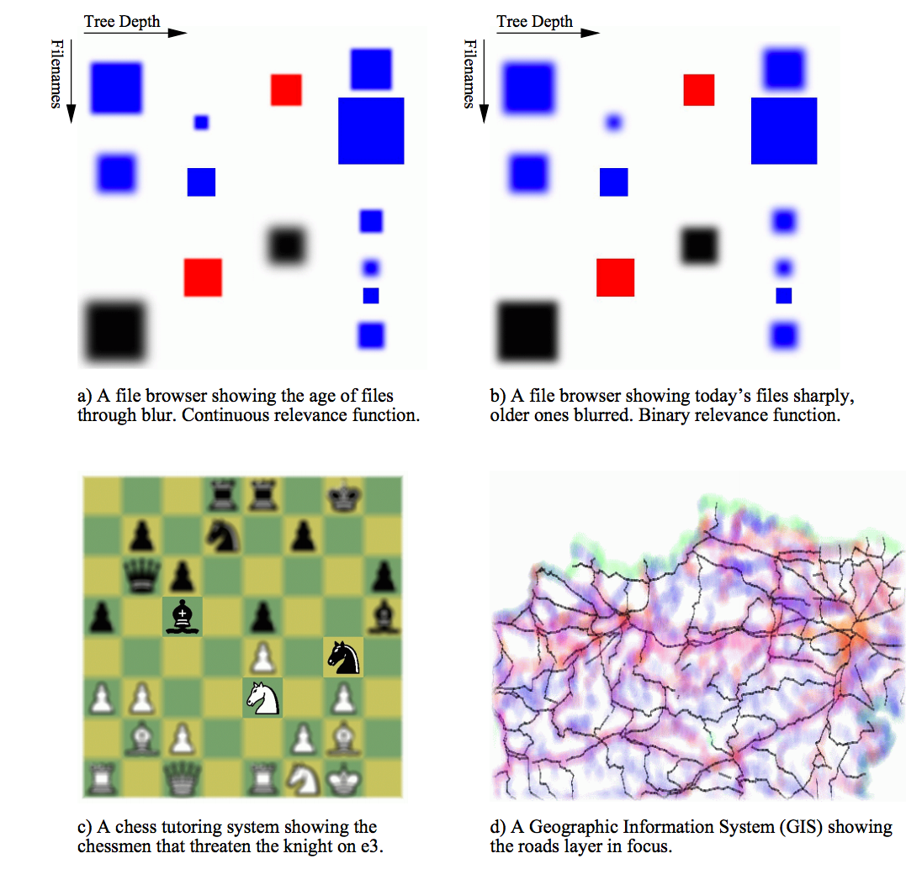
Visualizing Uncertain Data
Kosara et al, Semantic Depth of Field. Infovis01
Notes:
make things blurry and fuzzy

Slide 39
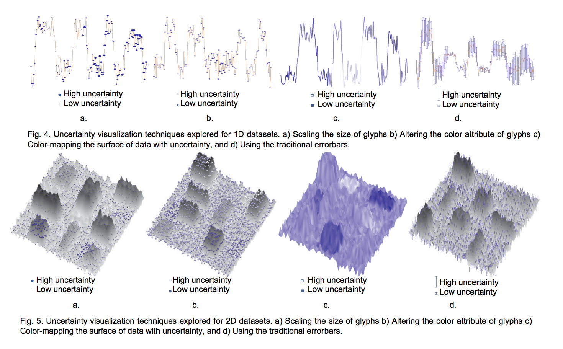
Visualizing Uncertain Data
Sanyal et al, A User Study to Compare Four Uncertainty Visualization Methods for 1D and 2D Datasets.
IEEE Transactions on 15.6 (2009)
Notes:
??? I don’t even know

Slide 40
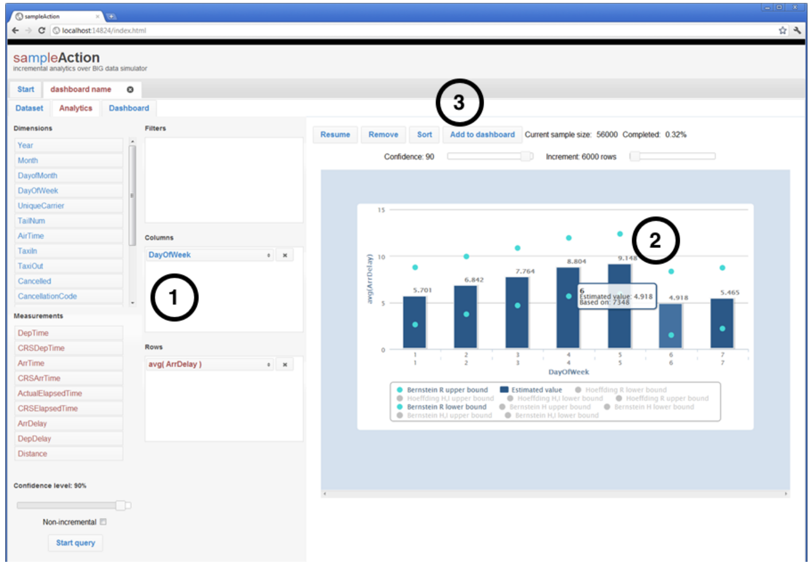
Visualizing Uncertain Data
SELECT AGG(M), D FROM R
WHERE … GROUP BY D
Notes:
shows the error bounds on a simple bar graph
the most generic example they can find

Slide 41
sampleAction - Interface
Drag and drop interface –
Users can move around dimensions and measurements
Can add filters
Shows results through bar charts with confidence levels
Also displays - current sample size, % completed

Slide 42
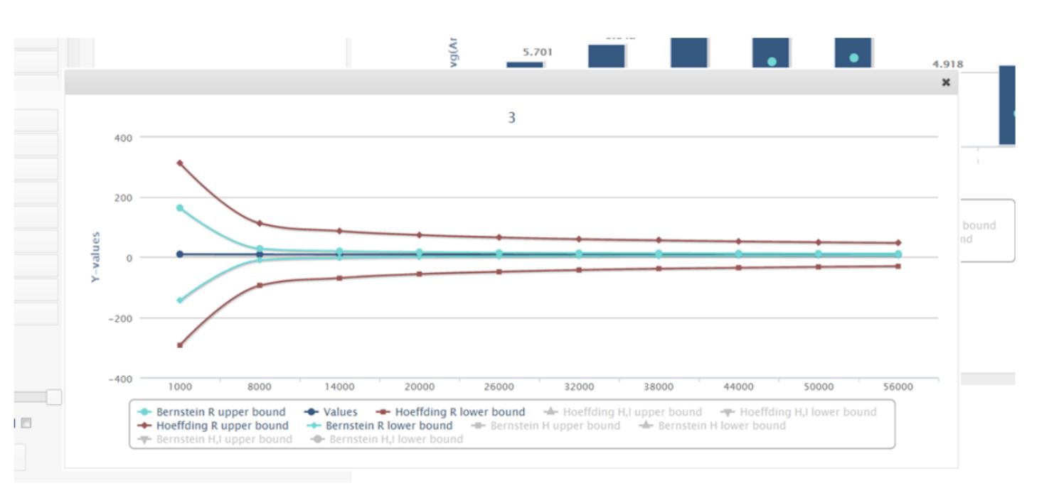
Convergence Rates

Slide 43
sampleAction - System
Data is randomly ordered in the database
An ad hoc incremental query system - queries top 500 and then top 1000 and so on.
The results gains accuracy overtime - error bound converges

Slide 44
sampleAction - System
Error bounds
Active area of research in probability theory
Bounds expand with variance of sample and tighten in proportion to the square root of the number of samples
Choice of estimator is very important!
Users could select different bounds, but not emphasized

Slide 45
sampleAction - User Study
Goals:
Are confidence bounds confusing?
At what point are the bounds “good enough”?
Does an OLA-like exploratory interface allow more exploration?
Notes:
system operations on a large network looking for network and server errors marketing organization,

Slide 46
sampleAction - User Study
Recruited 3 analysts to use their system Server ops, marketing, social media analysis
Asked them to think aloud during the study
Periodically asked how they would interpret results
Voice and screen interactions were recorded
Notes:
system operations on a large network looking for network and server errors marketing organization,

Slide 47
Bob: Server Operations
Looked through company server logs
Goal: Try to diagnose errors minutes after it happens
Through a quick query, he found out errors were coming from one data center
Says incremental systems might help them explore their archives => current approach is indexing?
Alert system is probably better
Notes:
bob is looking for rare errors in his logs, random sampling is probably not the best way to do this.

Slide 48
Allan: Online Game Reporting
Maintains database reports for a online gaming system
Normally uses OLAP cubes, not used to exploring data (runs same query often)
System did not work so well on regions with smaller samples
Confidence intervals were useless – switched it off
Compared age distribution of war games vs sports games: comparison
He enjoyed exploring his dataset!
Notes:
has record of every session and purchasing history
find errors in the data

Slide 49
Sam: Twitter Analytics
Analyzes Twitter data to understand relationships between use of vocal and sentiment
Used to visualize small samples on R
With this system, he can catch errors in his queries immediately
Started making discoveries (frequency of ‘angry’ in tweets)
Lot of keywords with a small number of samples, which led to larger confidence boundaries
Notes:
There is a lot of data! probably changes with time too.. probably not the best system for analyzing this much data

Slide 50
sampleAction - Analysis
There is value in getting quick responses
It provides an opportunity to explore the data and make more discoveries
Error bar convergence problems - noisy values, blocking the bar charts
People were confused with the confidence interval - no difference between small variance & but rare, and high variance & but frequent

Slide 51
Limitations
What are some limitations of the study? Acknowledged by the authors or otherwise.

Slide 52
Limitations
Simulated based on randomly ordered data
The estimates can be very inaccurate if the sample size is small. Users will have to wait for the error bound to get smaller
Small samples and outliers skew results
Depends on goals from visualizations
Unclear if conclusions are accurate; unclear if uses use approximate conclusions

Slide 53
Any other thoughts on the paper?
Writing
Presentation
Style
Experiments
Studies
Technical Depth

Slide 54
Followups
New system: Pangloss
Builds on sample+seek
Adds on ”optimistic visualizations”: simple idea Save approximate visualization results that can improve in the background

Slide 55
Optimistic Visualization
Assume that approximation is mostly right but offer a way to detect and recover from mistakes.
Analysts use initial estimates, run precise query in background, and confirm results later.
Gives users confidence in using AQP

Slide 56
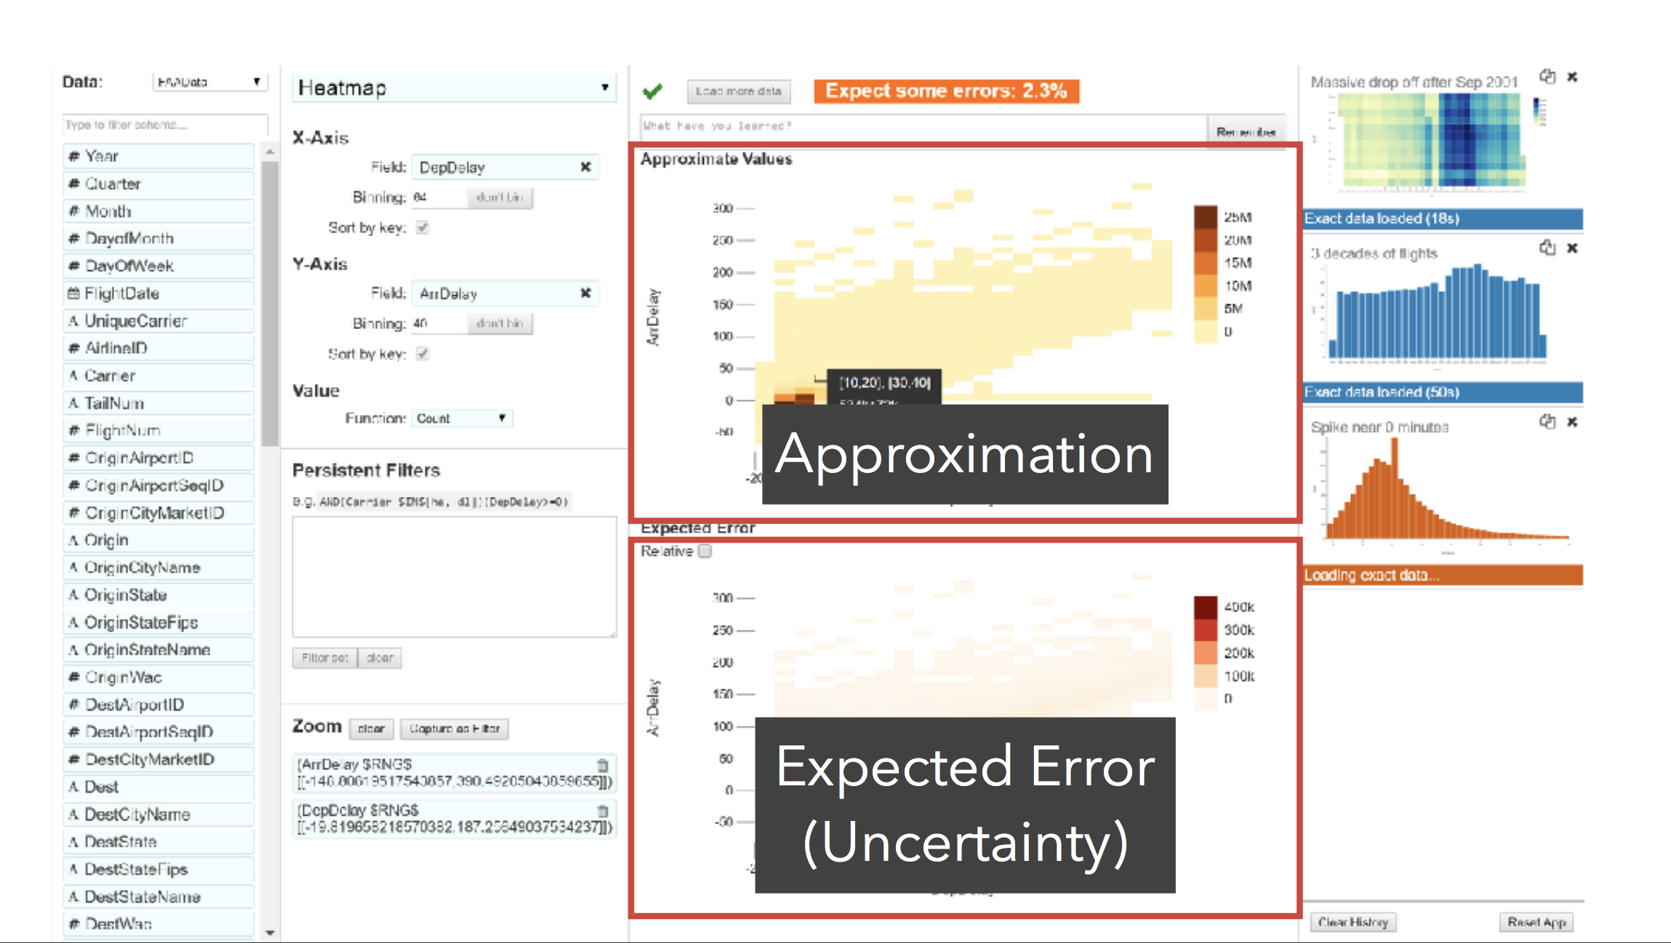

Slide 57
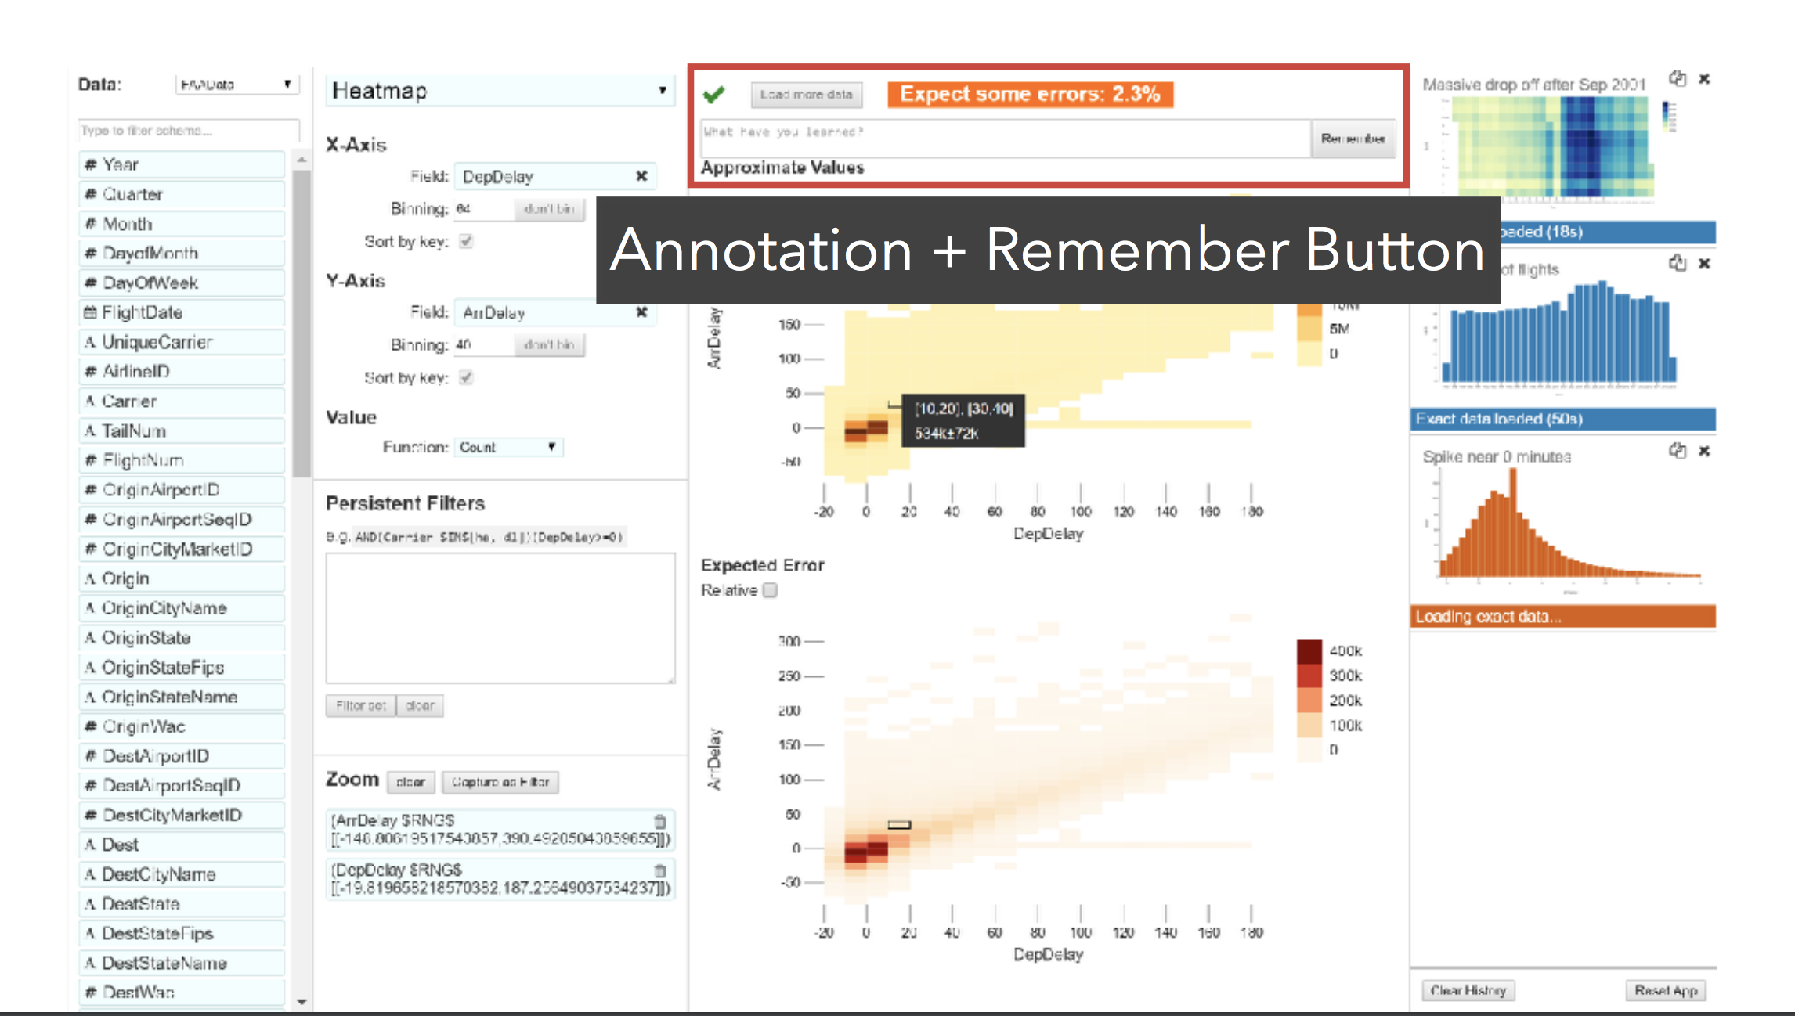

Slide 58
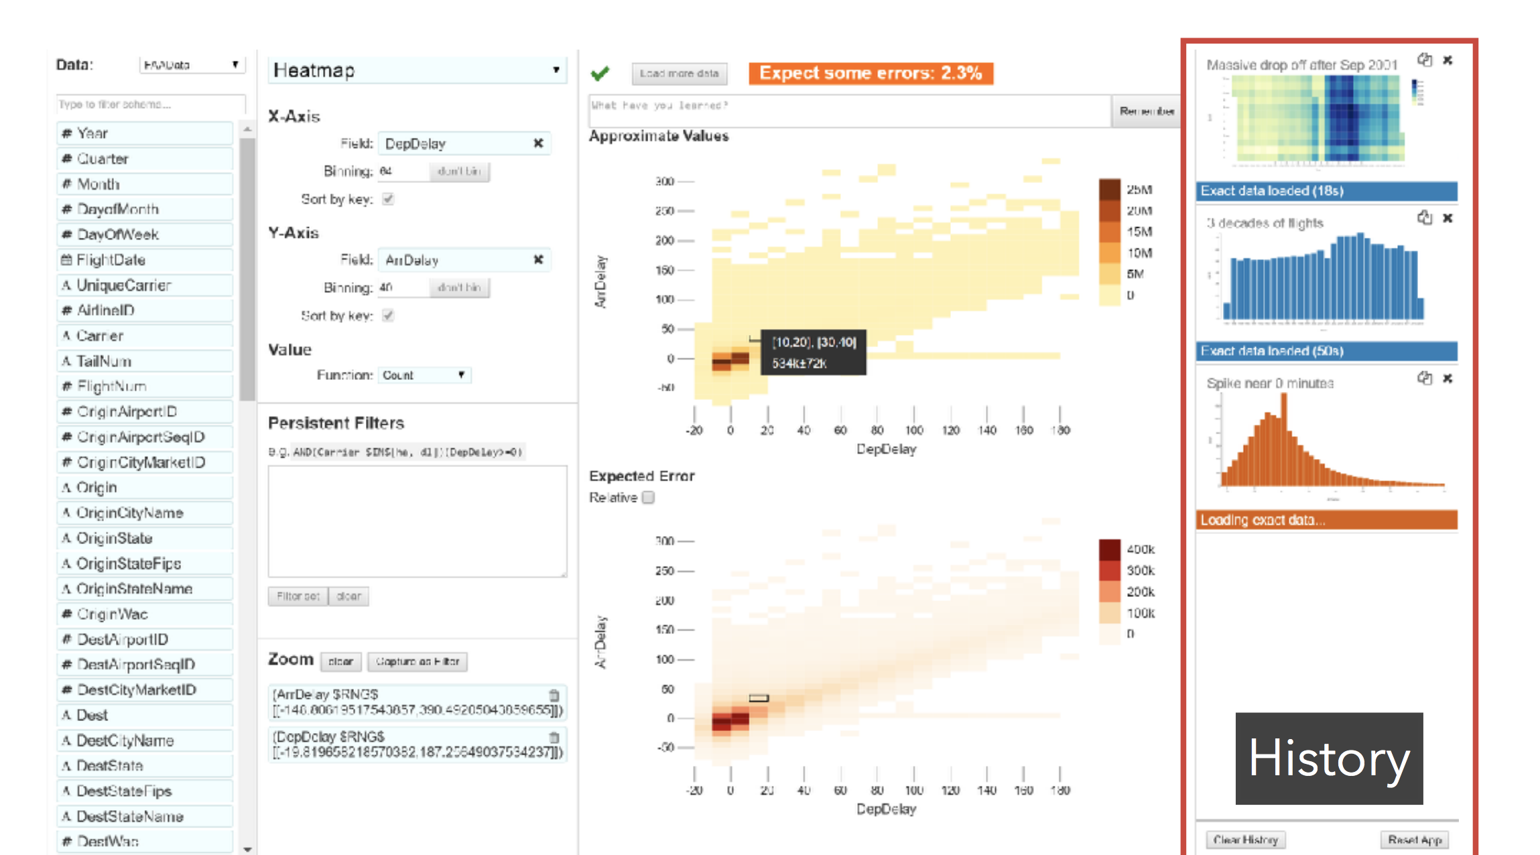

Slide 59
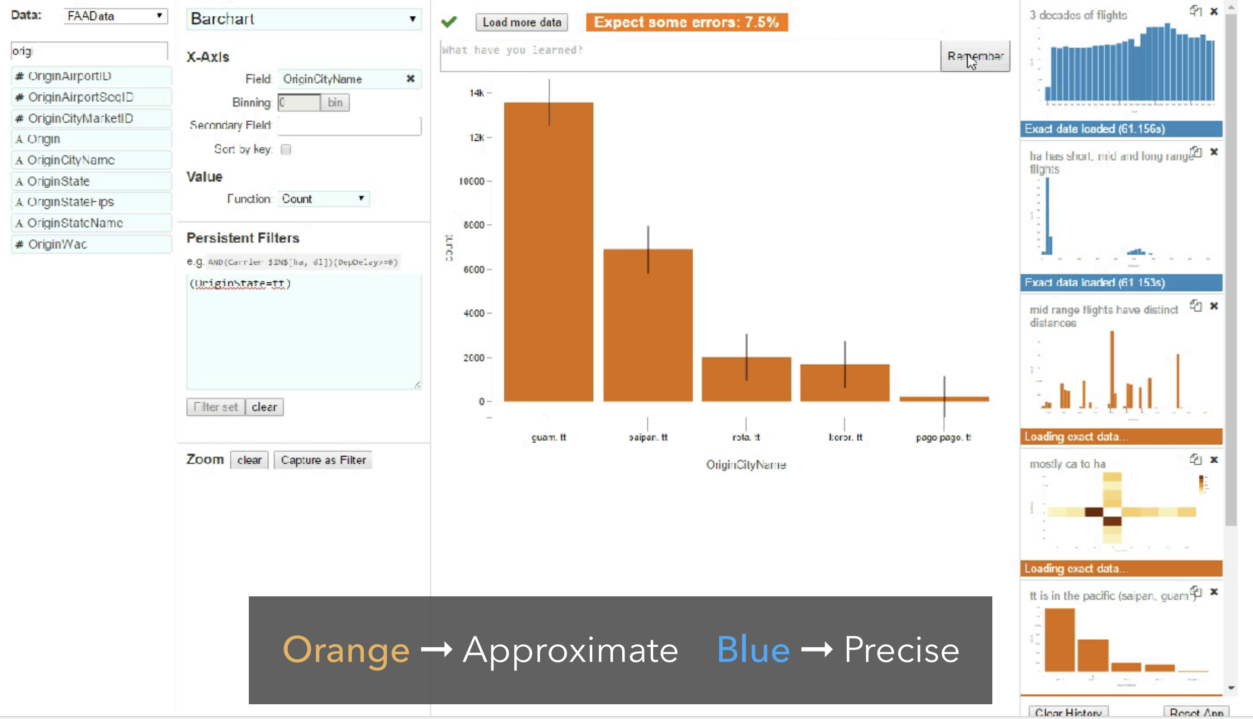

Slide 60
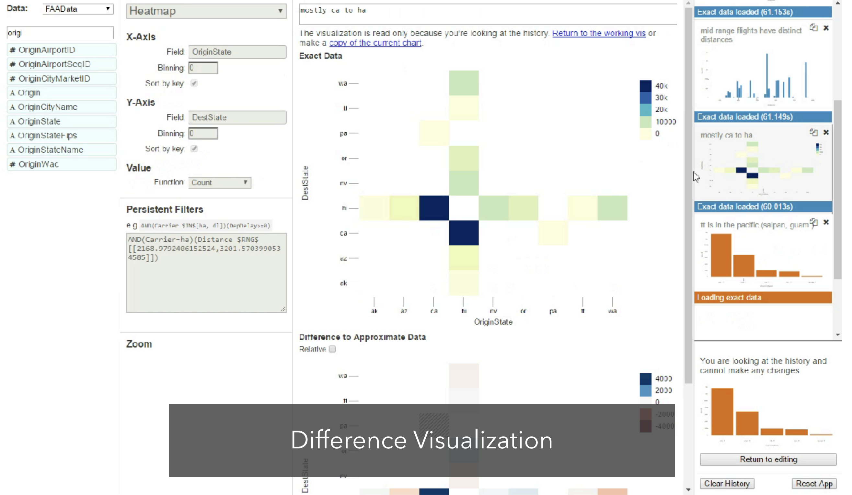

Slide 61
Study Findings
AQP works: “seeing something right away at first glimpse is really great”
Optimism works: “I was thinking what to do next— and I saw that it had loaded, so I went back and checked it . . . [the passive update is] very nice for not interrupting your workflow.”
Need for guarantees: “[with a competitor] I was willing to wait 70-80 seconds. It wasn’t ideally interactive, but it meant I was looking at all the data.”

Slide 62
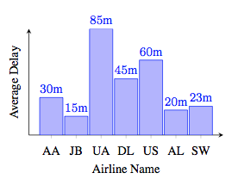
Bonus: Random Sampling for Vis w/ Ordering Guarantees
Q: SELECT X, AVG (Y) FROM R(X, Y) GROUP BY X
Analysts may want answers to:
Which airline has the largest delay?
Is delay of US > DL?
How much worse is UA than DL? 10X? 2X?
[VLDB ‘15]
Too Long!!

Slide 63
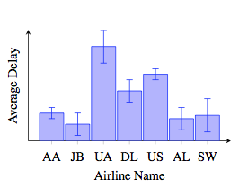
Approximate Visualizations
Insight: these questions are related to trends and comparisons, as opposed to actual values
Can we generate approximate visualizations that look like visualizations on the entire data but are computed on much less?

Slide 64
Visual Property of Interest
Can we generate approximate visualizations that look like visualizations on the entire data but are computed on much less data?
Our definition of “look like”
correct ordering property
if AVG(UA) > AVG(US) in the data, then it must be so in the visualization
We consider other properties in our paper…

Slide 65
How do I proceed?
How do I get the minimum number of samples?
In what order should I sample? How much?
Should I sample from UA (larger CI, fewer conflicts) or AL (smaller CI, more conflicts)?
When do I stop?

Slide 66
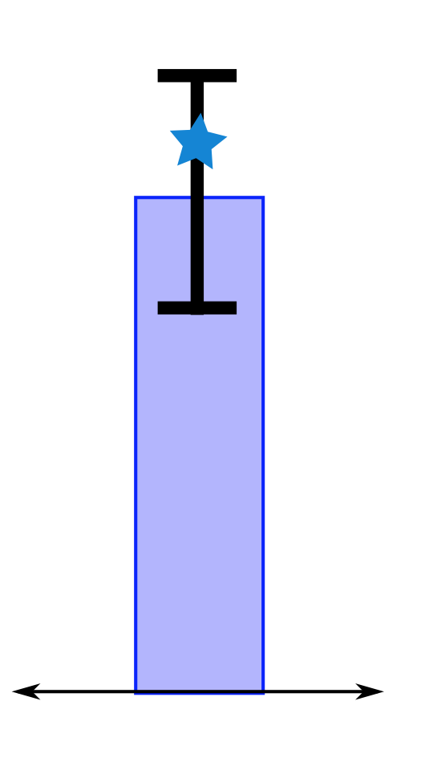
Ingredient 1: Confidence Intervals
Hoeffding-Serfling Inequality
Guarantee over iterations on repeated samples
No assumptions about distribution

Slide 67
Ingredient 2: Algorithm
Set all groups as active
While any active groups remain
Sample from all active groups (hairy formula)
Recompute CI (hairy formula)
Mark groups whose CI don’t overlap as inactive
Super Simple!

Slide 68
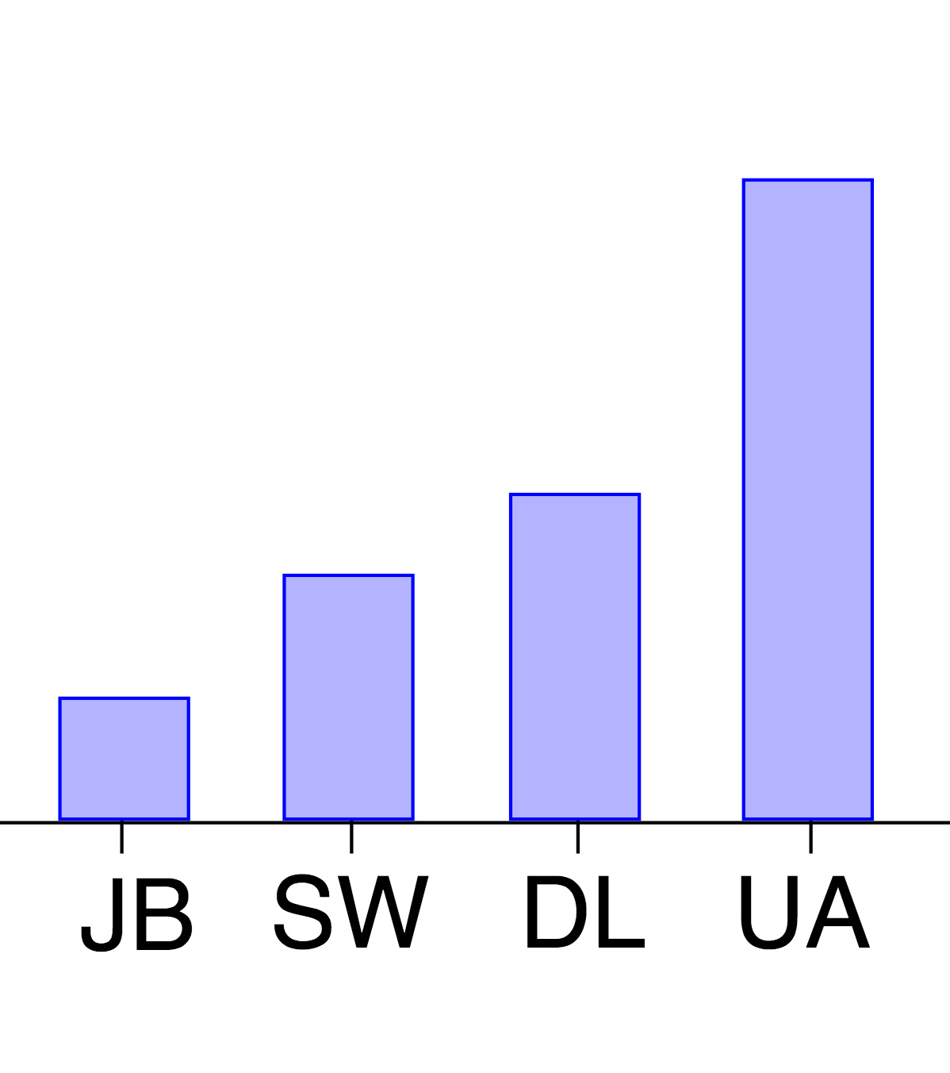
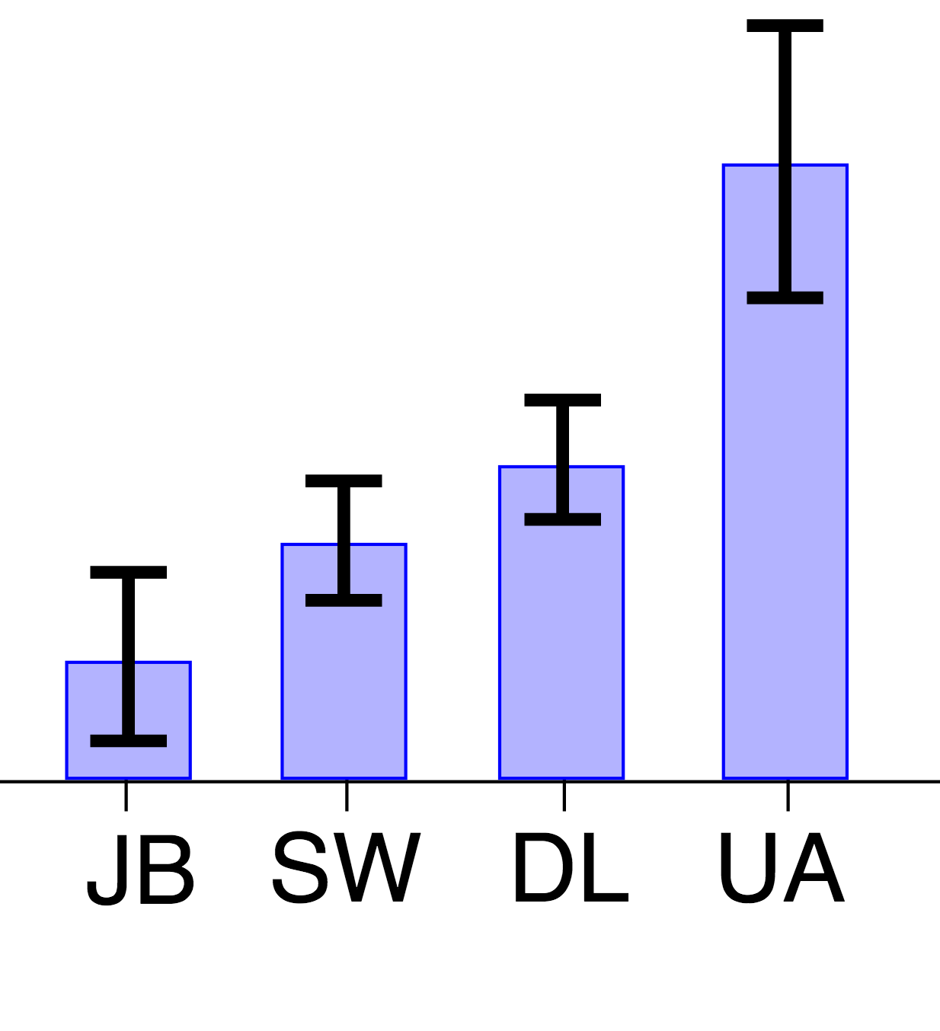
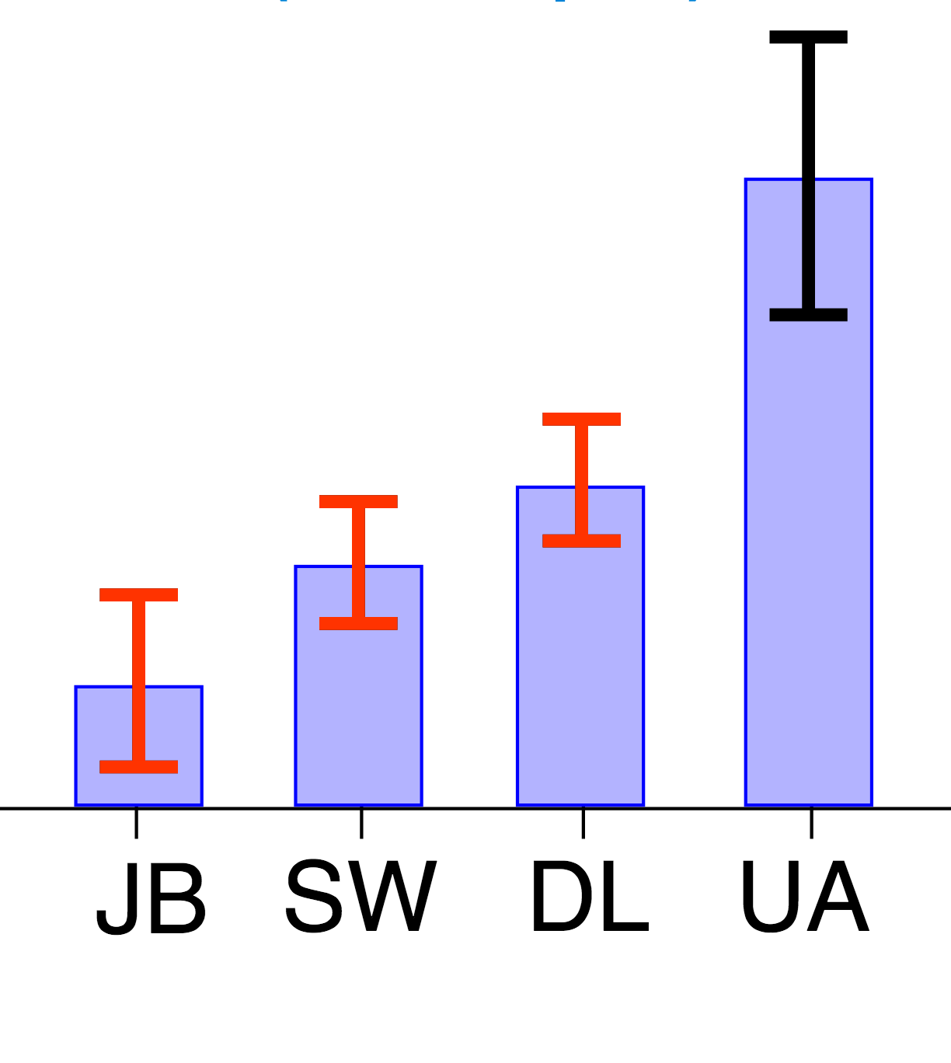
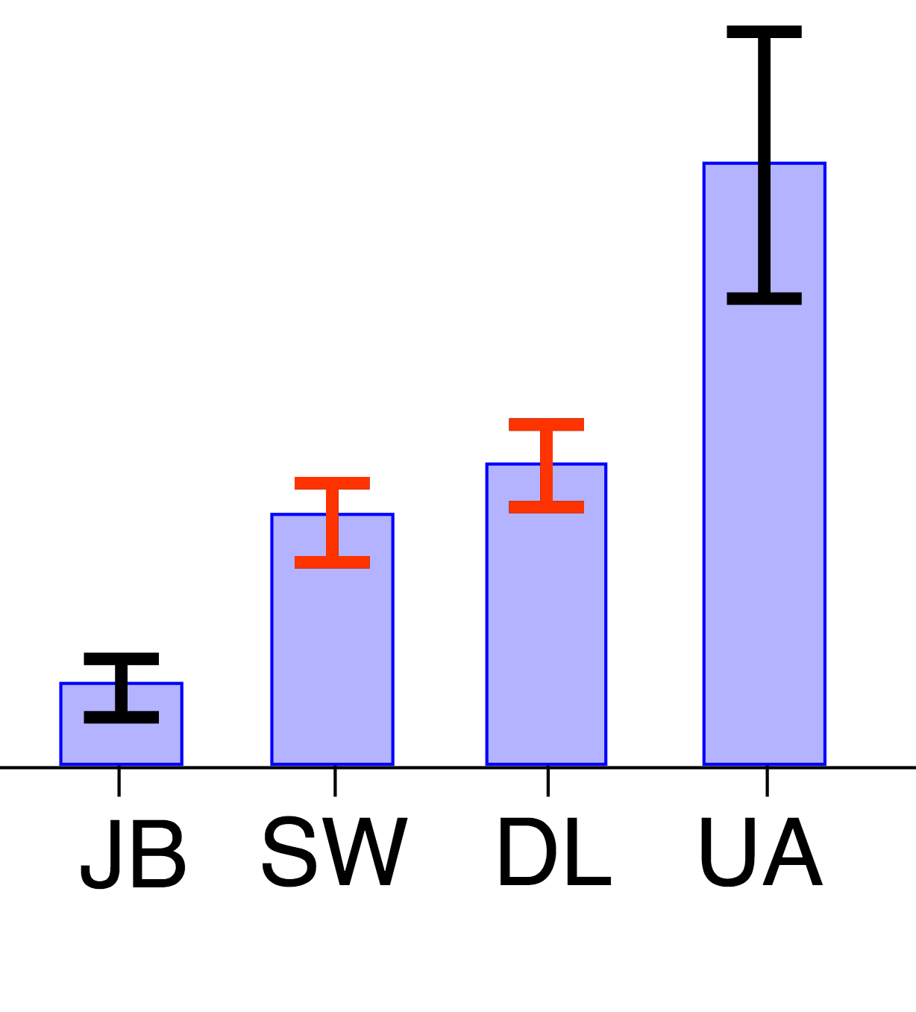
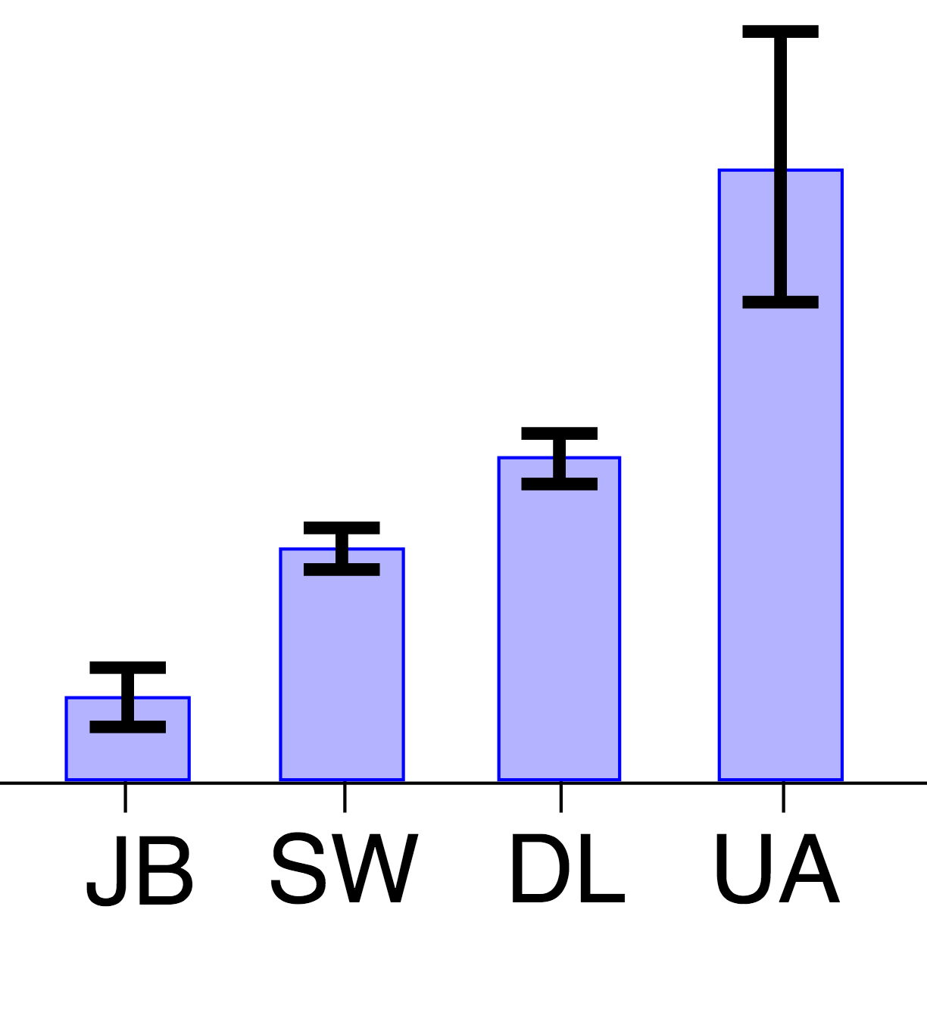
Execution of the Algorithm
Take samples from active groups
Update CI
Update active groups

Slide 69
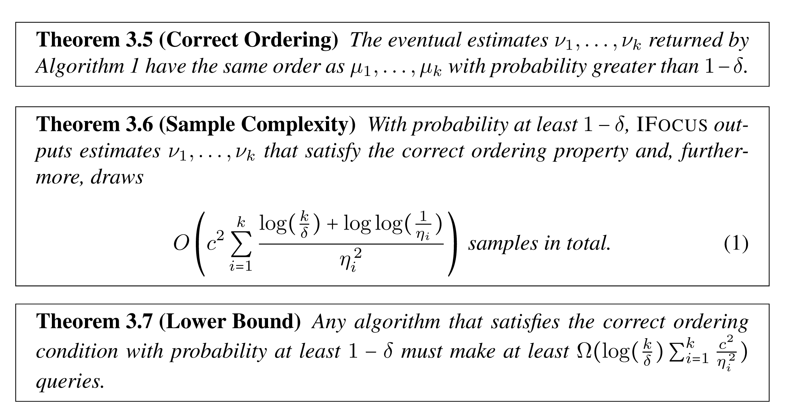
Theoretical Guarantees
It works!
Upperbound: Constant dependent on the inverse distance² between groups
Lowerbound: constant dependent on the inverse distance² between groups

Slide 70
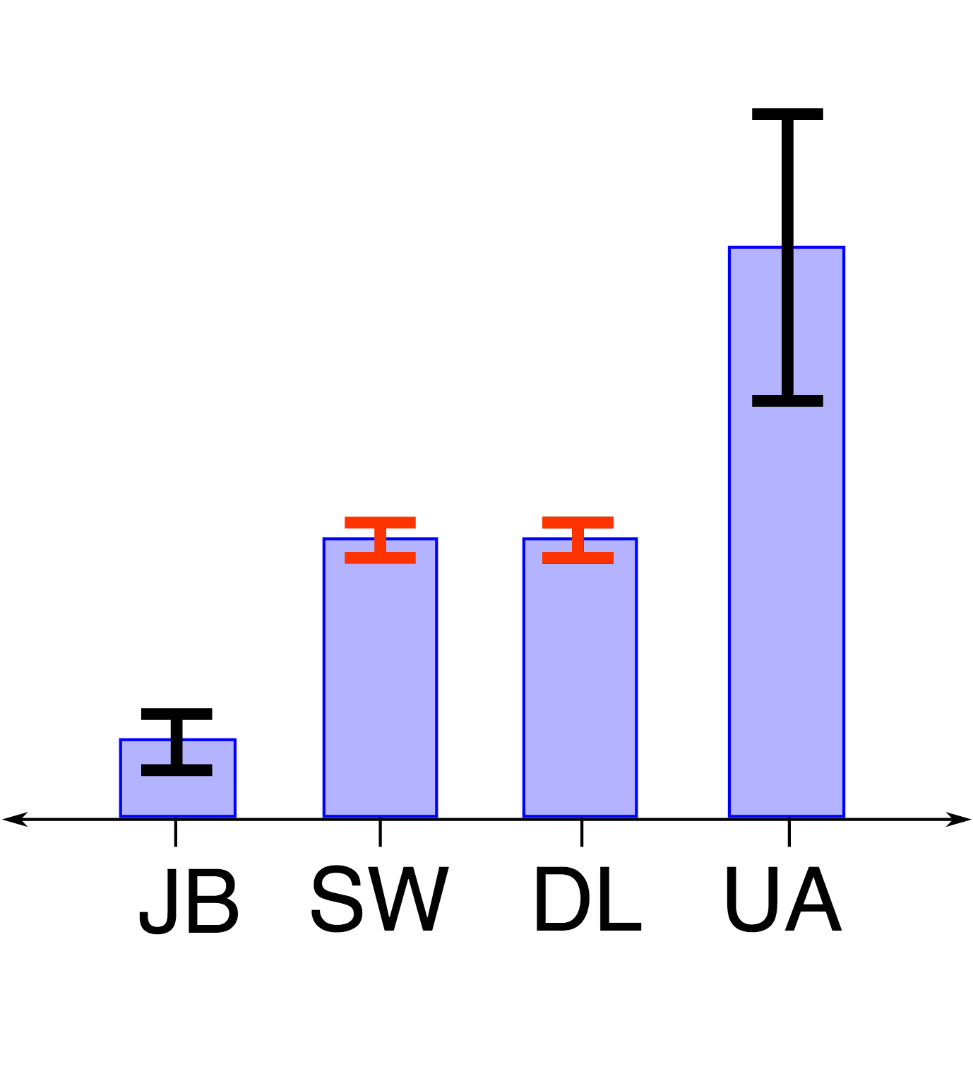
Ingredient 3: Perceptual Limits
If groups are
“too close to call”,
we can terminate early instead of sampling more

Slide 71
Experimental Details
Algorithms:
IFocus / IFocusR
Roundrobin/RoundrobinR
Scan
Datasets:
Synthetic (vary dist, size, #groups, skew)
Real (flights dataset, billions of rows)

Slide 72
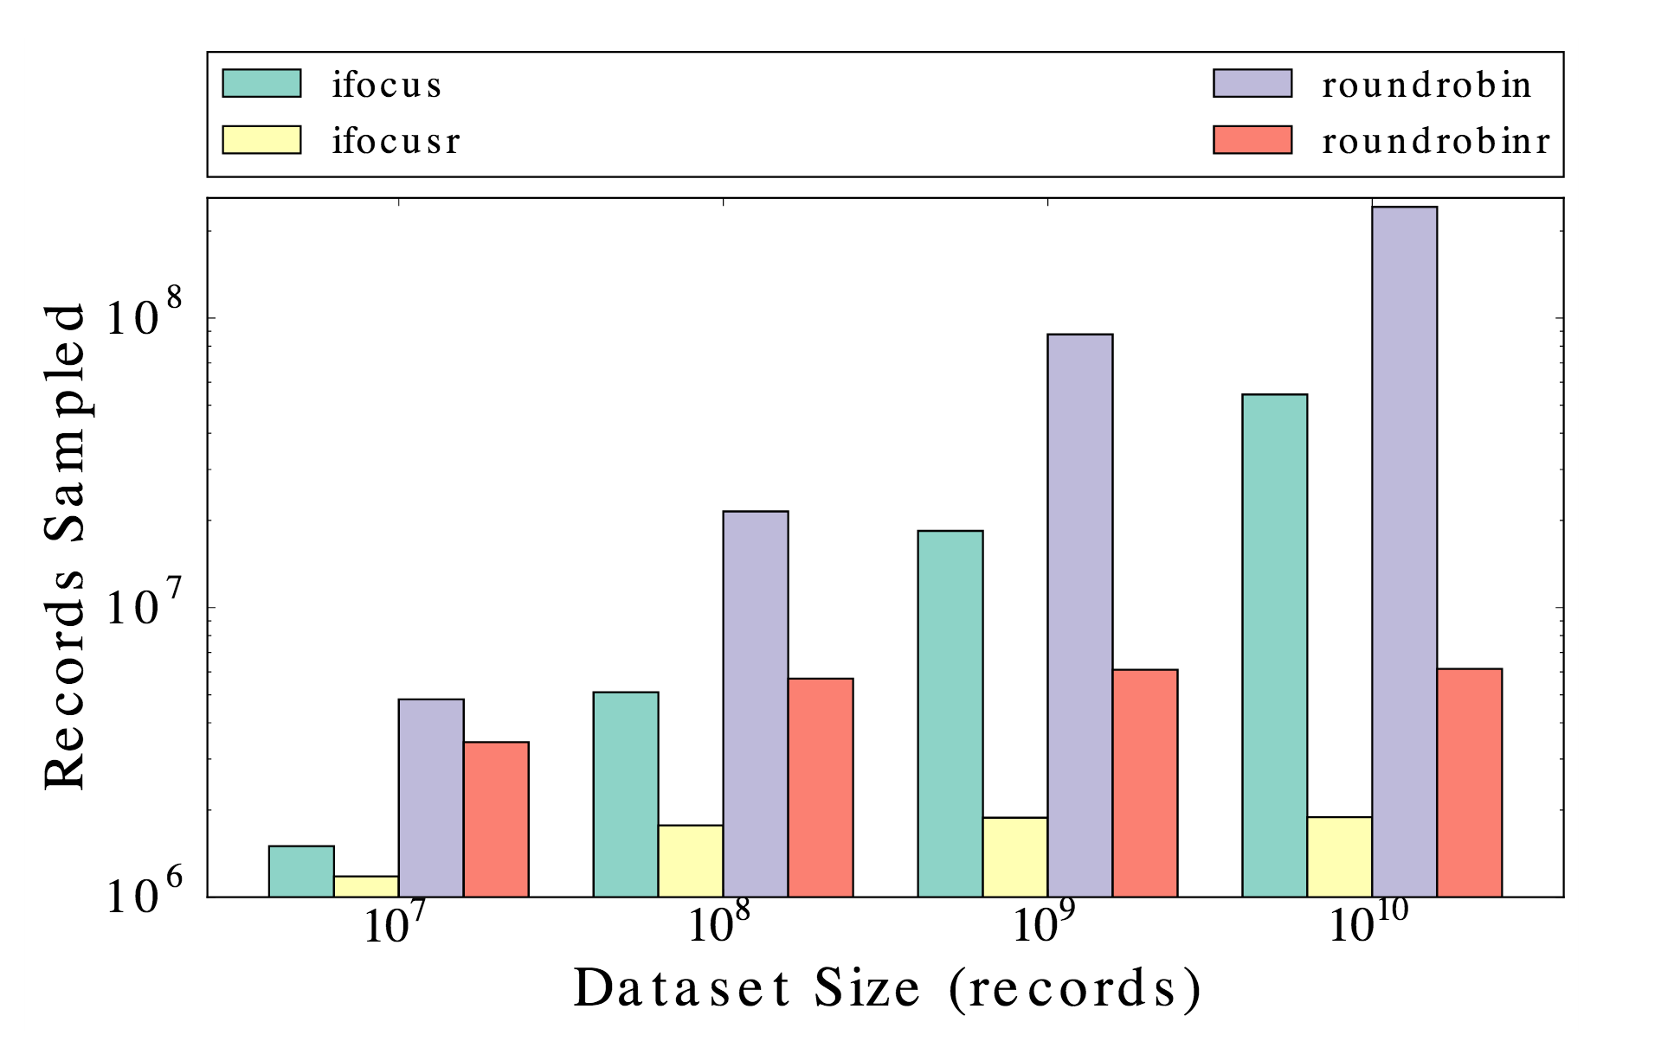
Data Size vs. Records Sampled
~1%
~0.01%

Slide 73
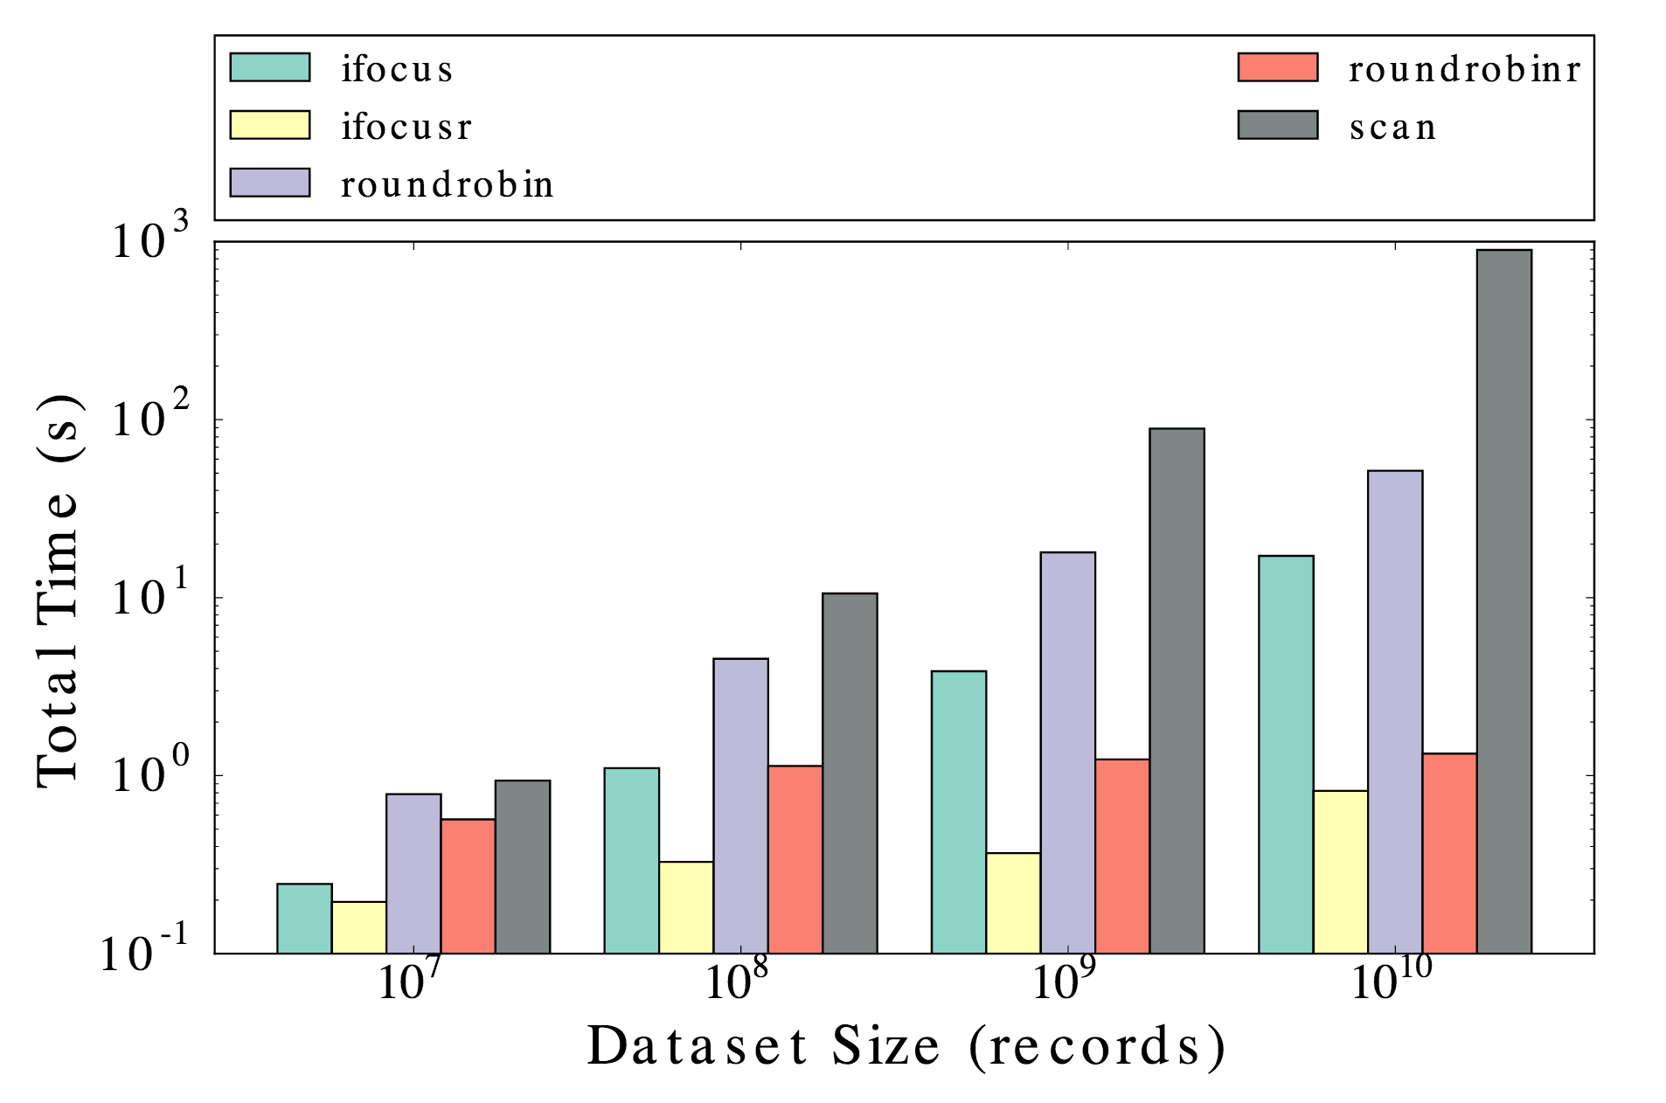
Data Size vs. Time

Slide 74
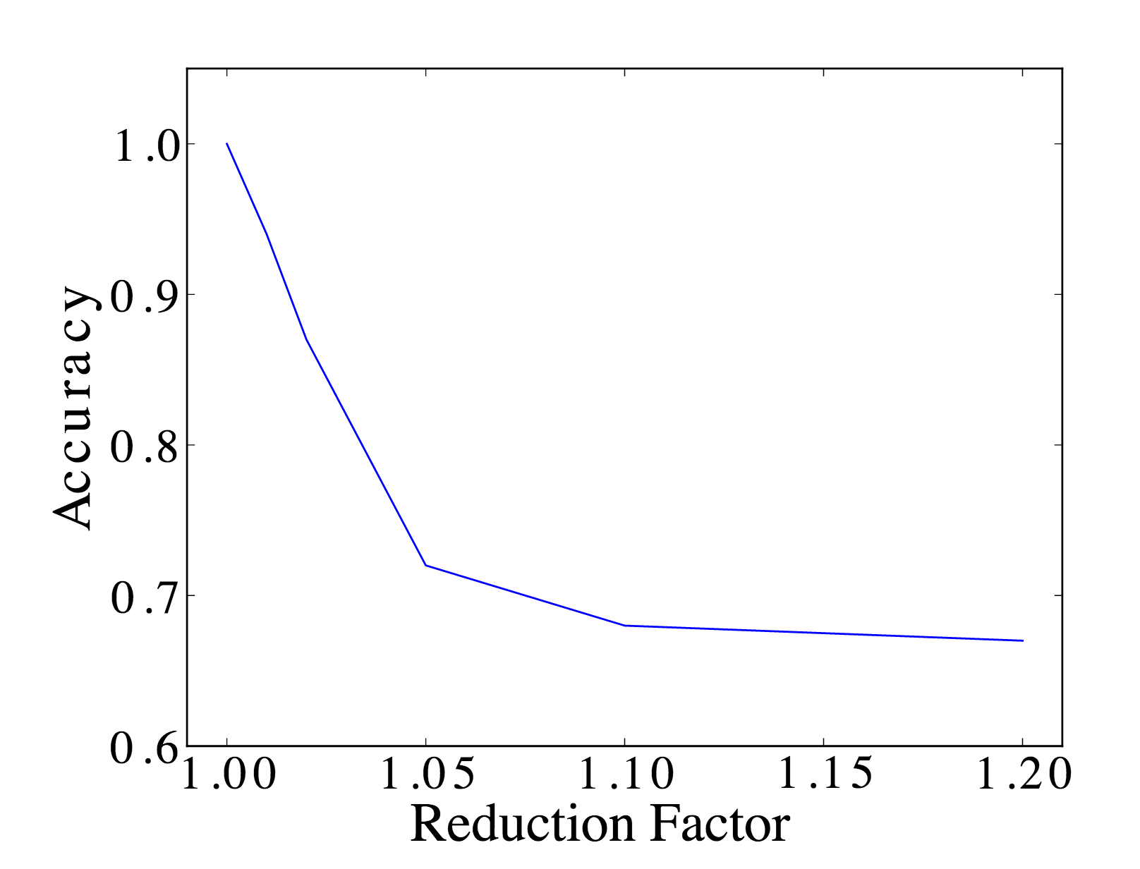
Accuracy
100% Accuracy!

Slide 75
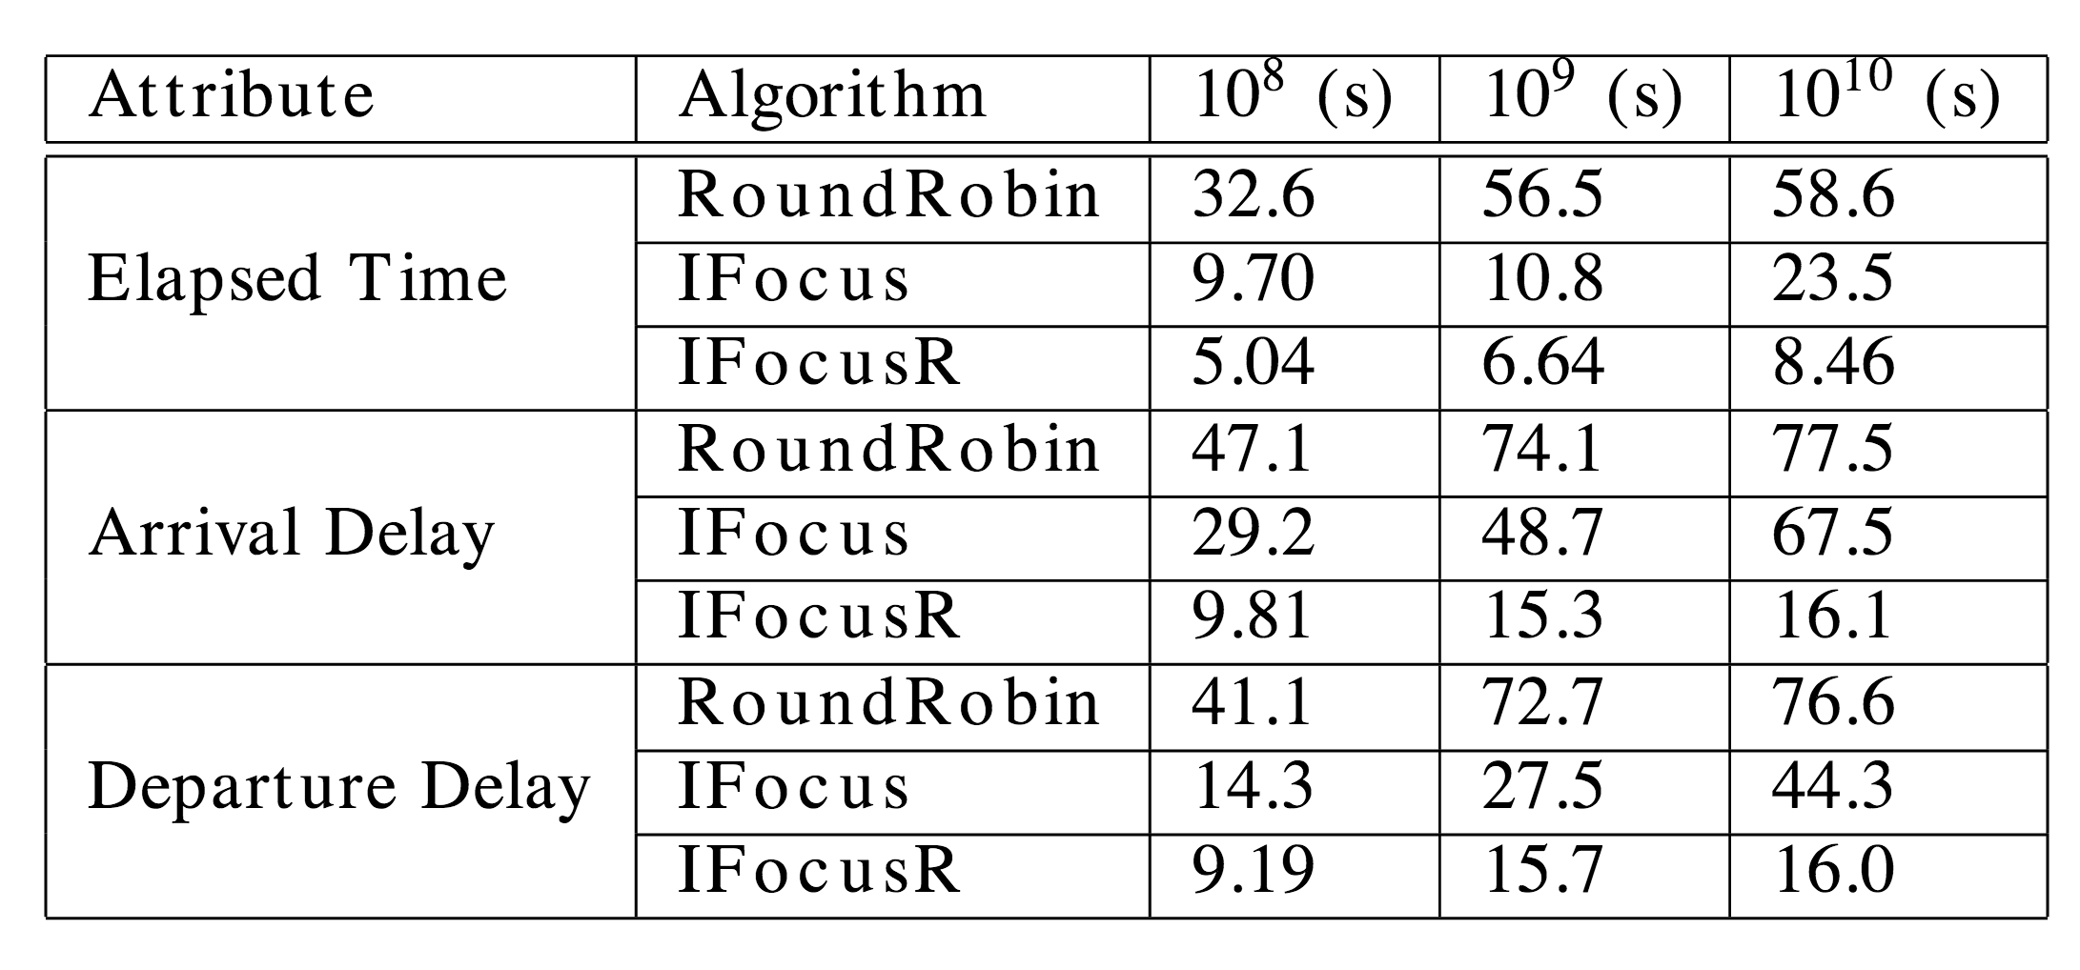
Real Data Experiments
This is actually a hard case for our algorithm!

Slide 76
